Slide 1

Campaign for Domestic Violence

Slide 2
Domestic Violence
Refers to violence, intimidation and abuse among people who are presently or previously been in an intimate relationship.
Involves all attempts by one partner to control and dominate the other.
Domestic violence uses shame, fear, guilt and intimidation to wear the other person down and keep them under their thumb.
More than 12 million men and women on a yearly basis face domestic violence.
24 people per minute are victims of physical, emotional or financial violence by an intimate partner in the United States

Slide 3

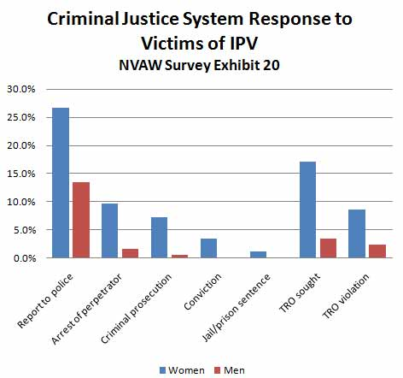
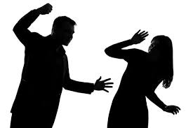
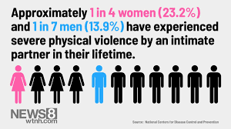
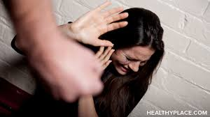
Women form the greatest percentage of total domestic violence in U.S. They also respond quickly to domestic violence
Notes:
Women form the largest percentage of the total domestic violence in the united states. 60% of women are physically assaulted by their spouses or partners in their lifetime. This means that nearly 3 in 10 women have experienced physical violence, rape or stalking by a partner.

Slide 4

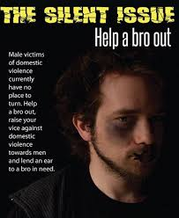
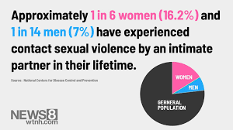
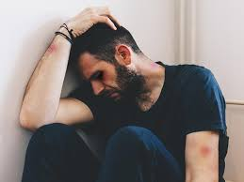
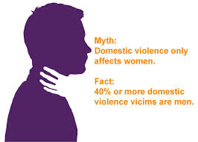
Men suffers in silence in domestic violence
Notes:
Men are also victims of domestic violence. Most of them fear to come out and speak against it. They therefore suffer physically, emotionally and psychosocially without any form of help at their disposal. This should be condemned. More than 40% of total domestic violence victims in America are men.

Slide 5


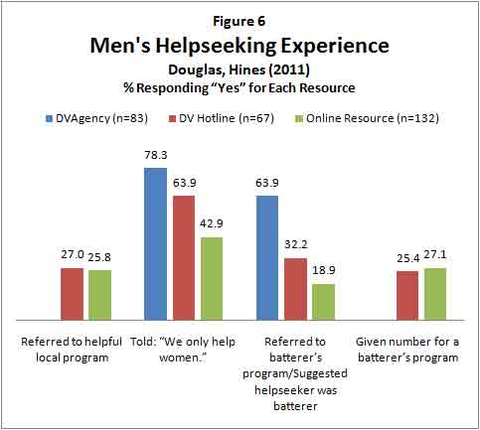

How To Help Out
Notes:
Women have more help mechanism than men. More programs should be created to assist men to speak out when domestically victimized. Men have reported low response to domestic violence than women. They fear to come out. Workshops and seminars, therapies and response mechanism should be created and enhanced to prevent domestic violence.

Slide 6


Stop domestic violence campaign
Address domestic violence at social gatherings.
Educate youngsters of dangers of domestic violence.
Create workshop and seminars for intimate partners to discuss domestic violence.
Increase and improve therapy for domestic violence victims.
Use social media radio and television to campaigns against domestic violence
Perform walks in the cities to condemn domestic violence.
Use posters in towns, schools, social halls and public transport to condemn domestic violence.

